Slide 1
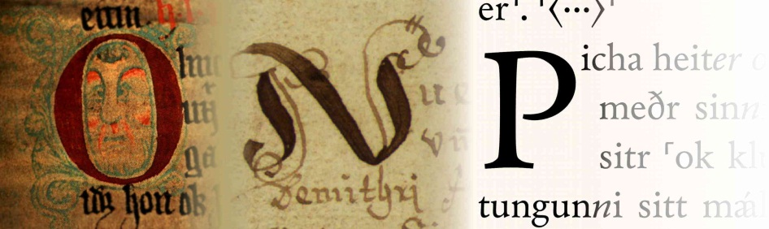

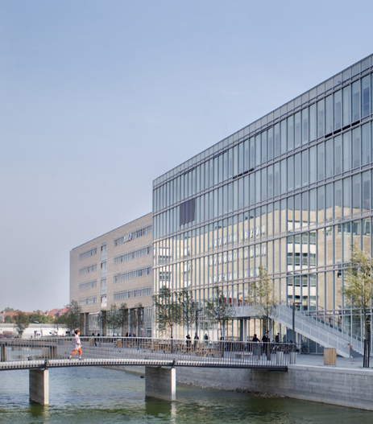
Lexical Data Masterclass, Berlin 4-8 December 2017
A Dictionary of Old Norse Prose
Progress and Perspectives
Simonetta Battista, Ellert Thor Johannsson
Department of Nordic Languages and Linguistics
University of Copenhagen

Slide 2
Our plan for the week
Learning more about xml and how it can be useful in lexicographic work
Understanding more about incorporating digital xml scholarly editions into the existing dictionary structure
Finding a way to compare information from lemmatized texts to the corresponding examples found in the ONP collection of citations

Slide 3
Main tasks
Attempting to create a TIE xml-entry for our Dictionary
Converting an xml version of an Old Norse text to a structured TIE document which focuses on the word specific information encoded in the original file.
A two step process:
Converting the original document to a TIE compliant xml document
Converting this new TIE document into a basic glossary containing headwords with all the relevant examples from the text
…. and then adding some formatting

Slide 4
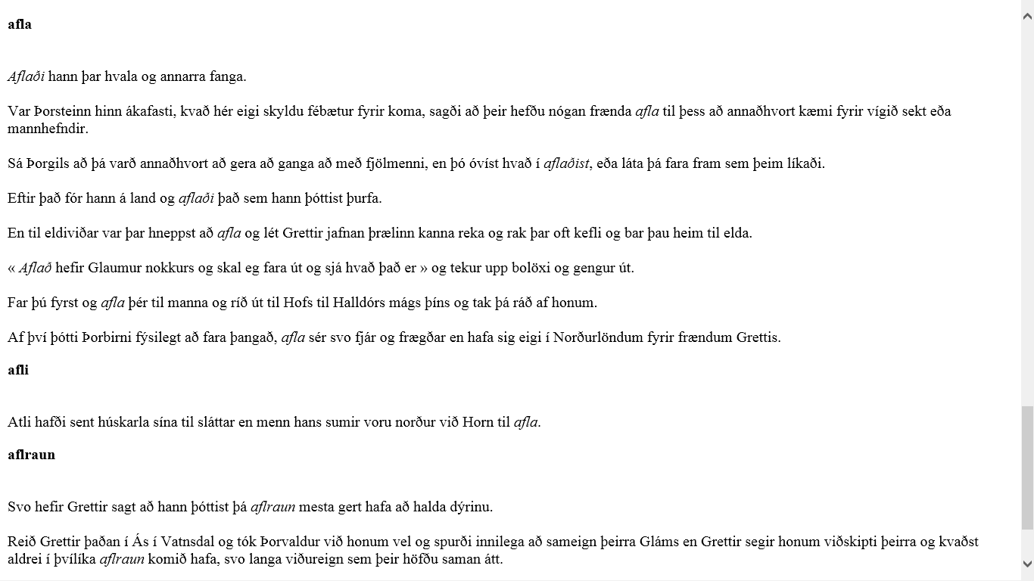
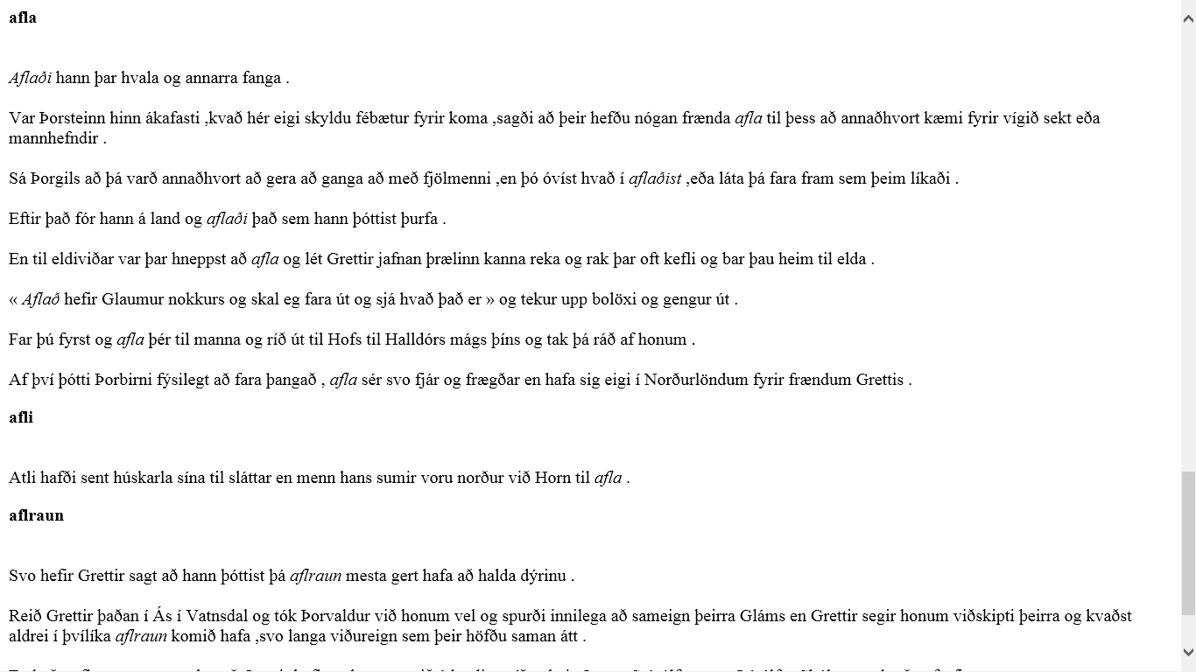
Structured glossary

Slide 5
Future perspectives
Comparing the inventory of headwords and citation examples from our TEI document to the manually excerpted material found in the database of our dictionary
Using this information to improve our citation material
Getting some statistical information about how different genres of Old Norse literature are represented in the existing collection of citation

Slide 6
Thank you for a great week!

